Slide 1
Bar POS System
Created by Cole tucker, Kara Myers, Ana Siemens and Sarah Dion
Student usernames: c.tucker073, k.myers973, a.siemens710, s.dion045

Slide 2
Database -> Tables:

Slide 3

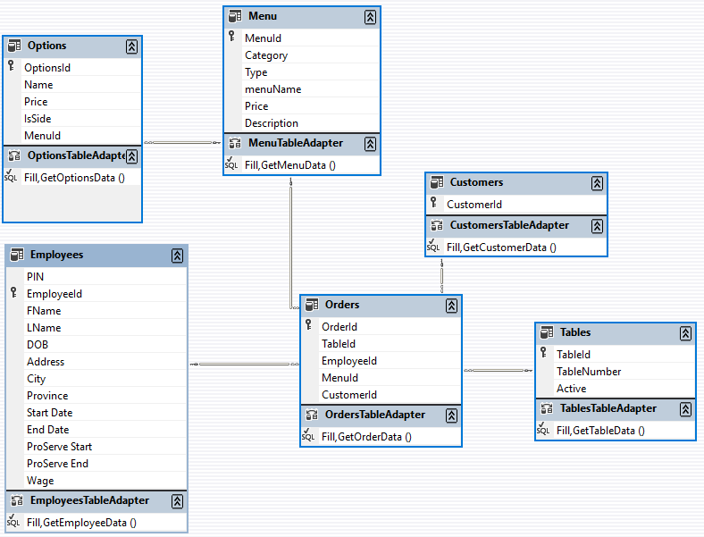
Relations between Tables:

Slide 4
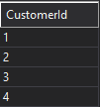
Customers
The customer table is used to distinguish between different customers in the bar.

Slide 5
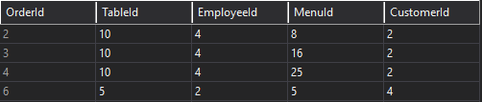
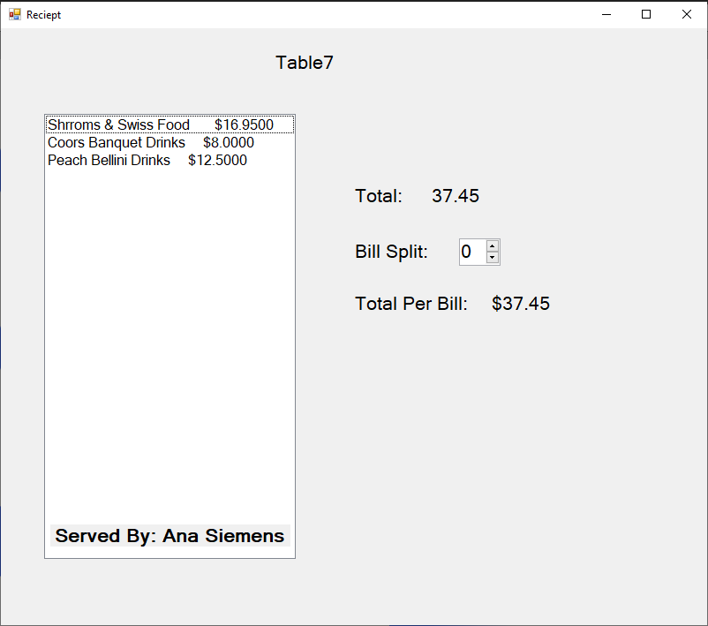
orders
The orders table is a table full of a bunch of keys. The table relates between all the other tables to add the customers order to the receipt. The table also keeps tracked of the table, who was their server which customer, as well as what they ordered.

Slide 6
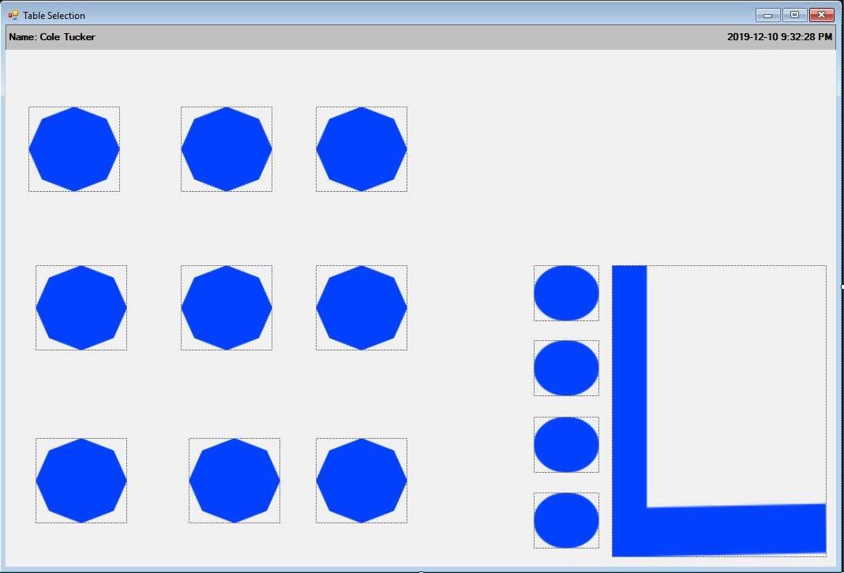
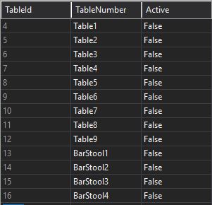
tables
The tables table is used to give all the tables and barstools an id as well as a table number that everyone can see , to make it easier for people to differentiate. As soon as the server clicks on the table to add an order the active column changes from false to true.

Slide 7
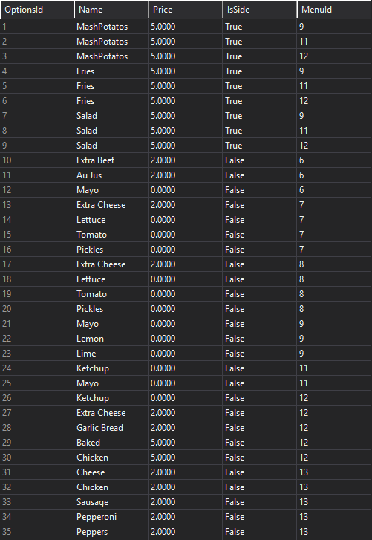
Options
The options table is used to hold the types of sides or options you can add to certain menu items. The menu item column shows which menu item has that particular side or options. As well as the price that it would cost to add this to your order.

Slide 8
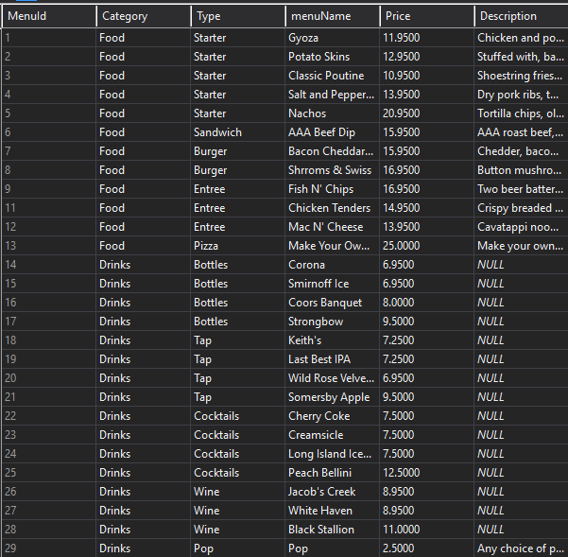
Menu
The menu table is used to hold all the food and drink items from the bar. The menuid is used to relate the menu items into the order as well to display them as buttons the employee can choose for their table.

Slide 9
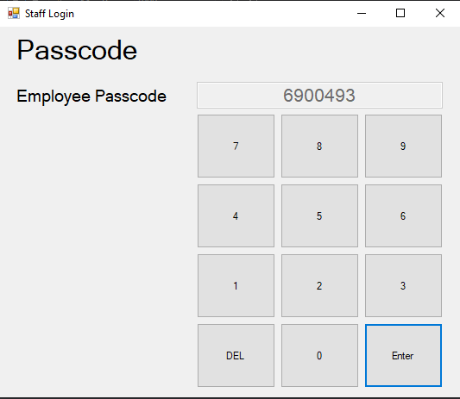
Employees
The employee table is used to grab the pin number so each employee can sign in. The Fname, Lname and EmployeeID are also used in the receipt to figure out, which employee the table was served by.

